Slide 1
Photomontage

Slide 2
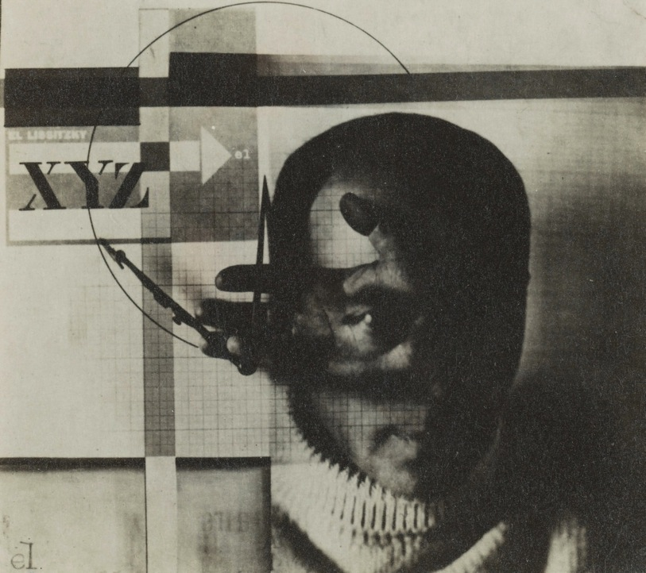
El Lissitzky

Slide 3
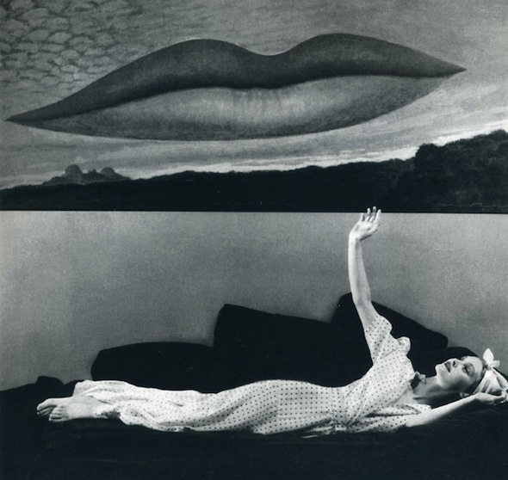
Man Ray

Slide 4
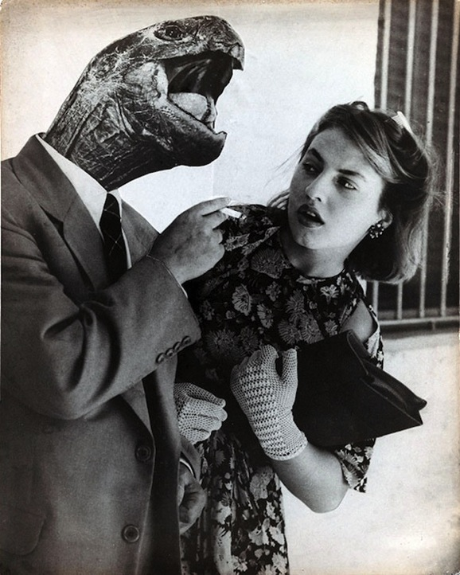
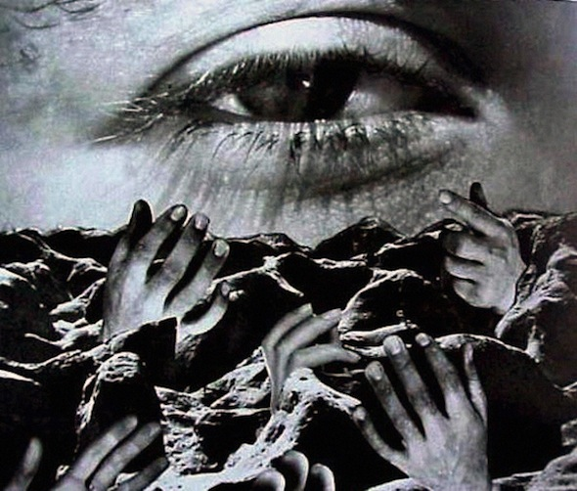
Grete Stern

Slide 5
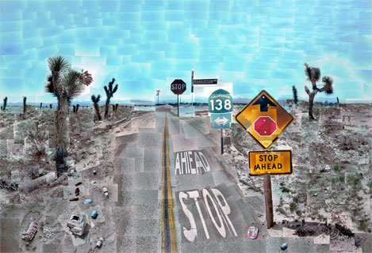
David Hockney

Slide 6
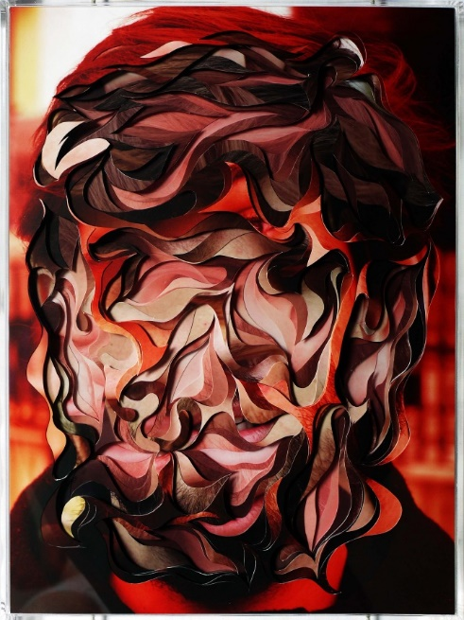
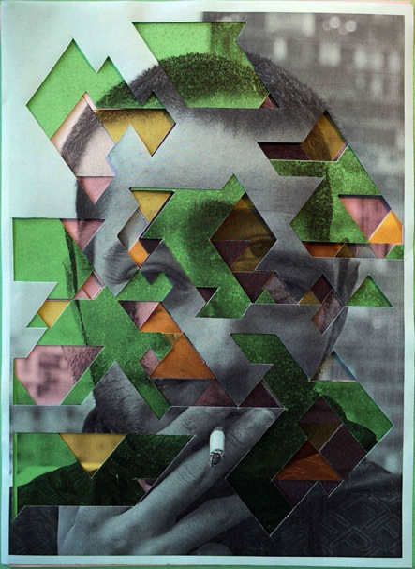
Lucas Simoes

Slide 7
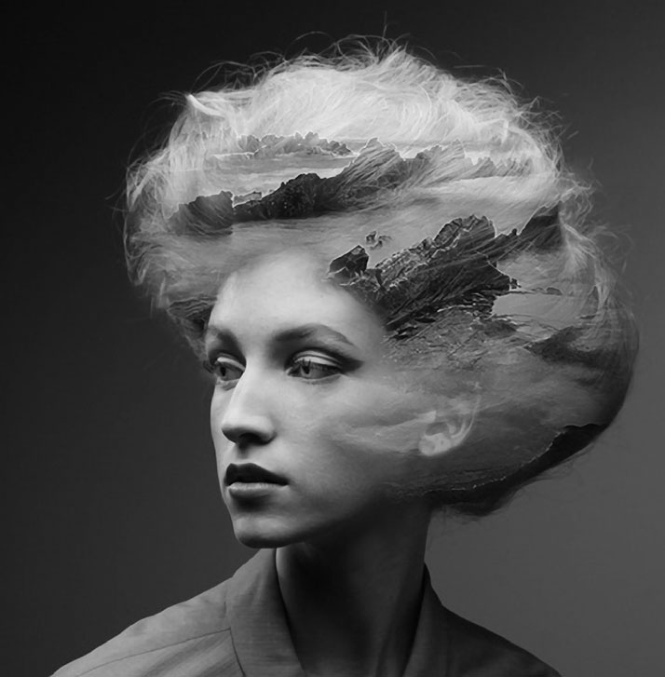
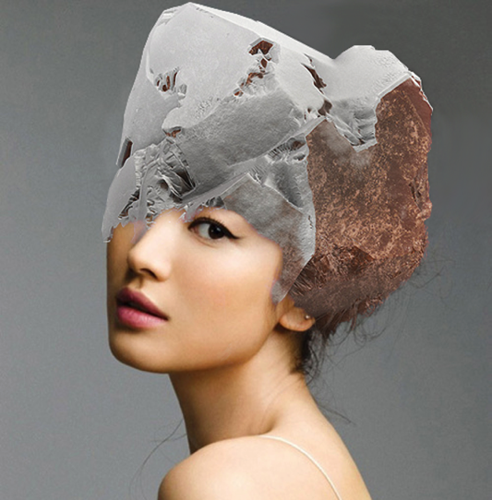
Matt Wisniewski

Slide 8
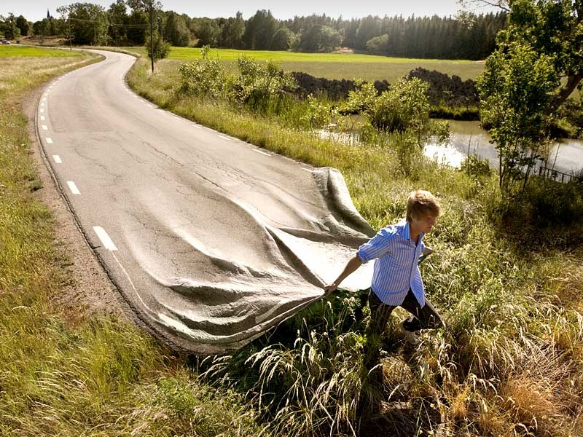
Erik Johansson

Slide 9
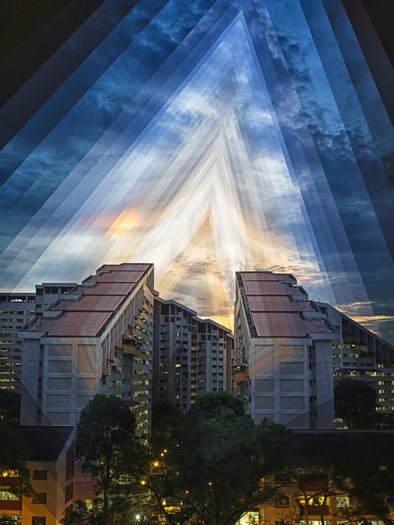
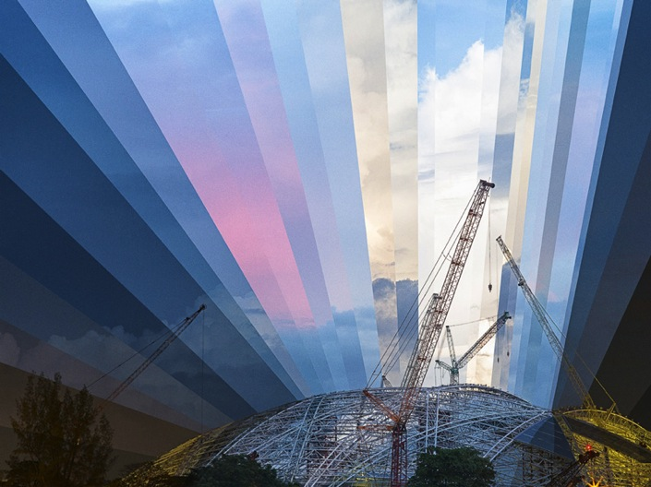
Fong Qi Wei

Slide 10
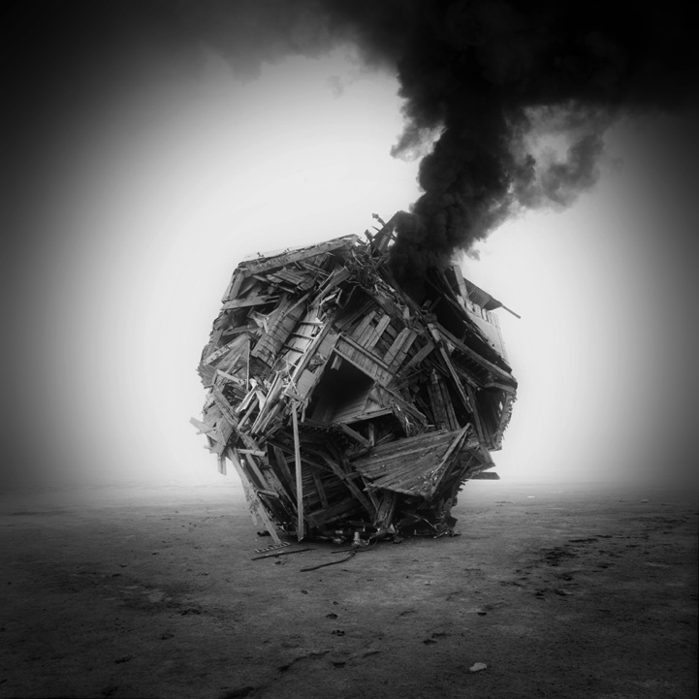
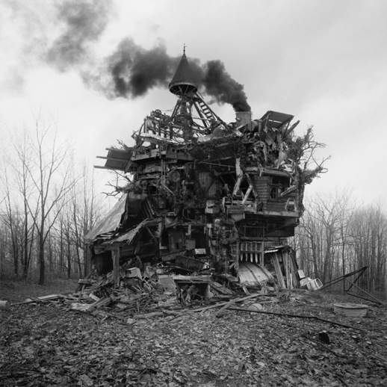
Jim Kazanjian

Slide 11
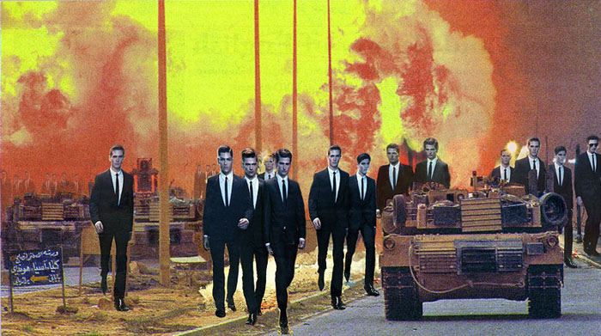
Martha Rosler

Slide 12
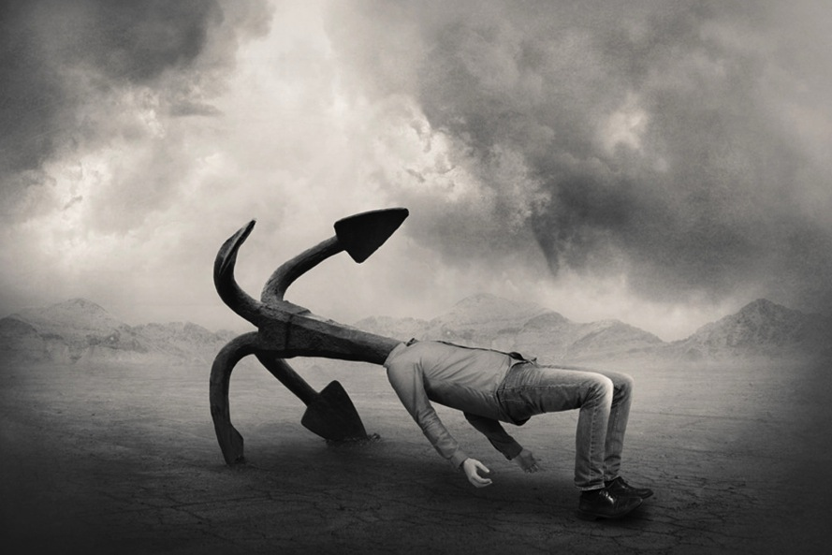
Tommy Ingberg

Slide 13
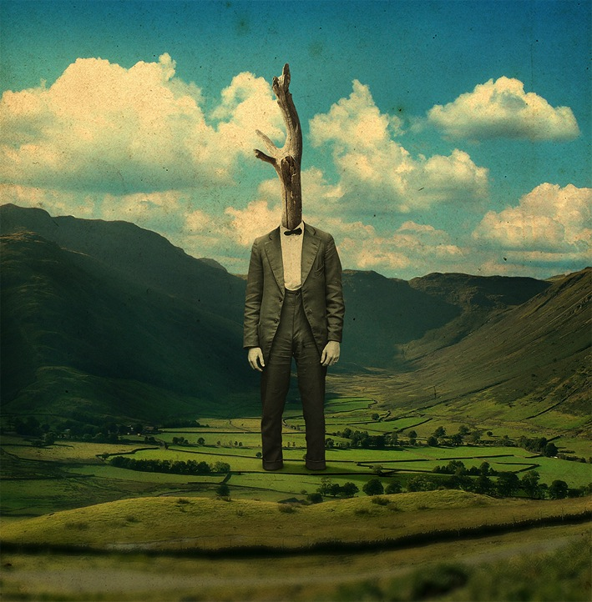
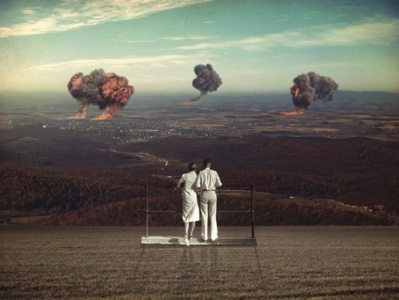
Joseba Elorza

Slide 14
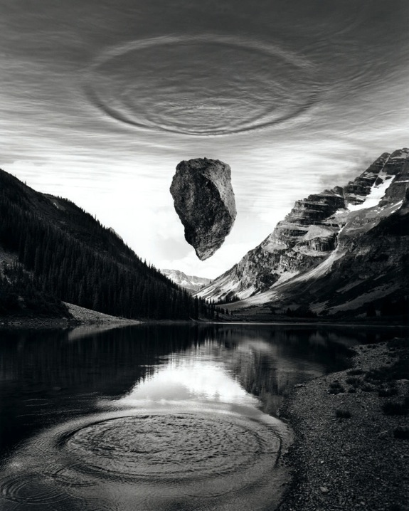
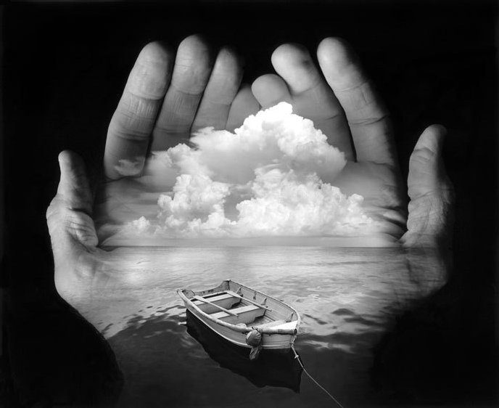
Jerry Uelsmann

Slide 15
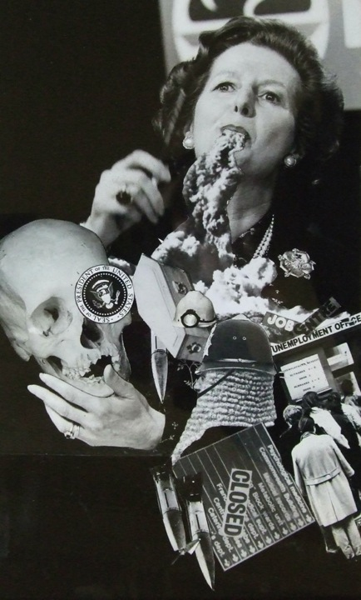
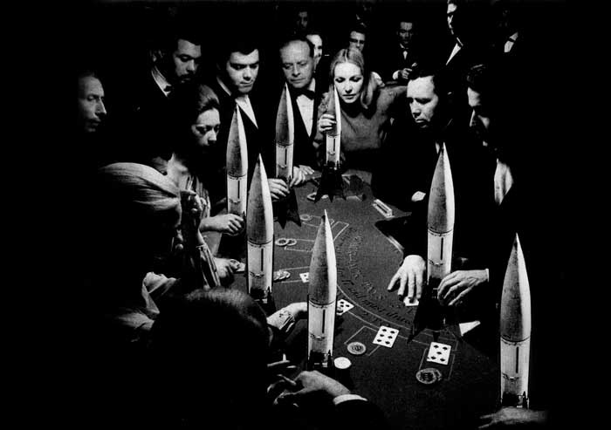
Peter Kennard

Slide 16
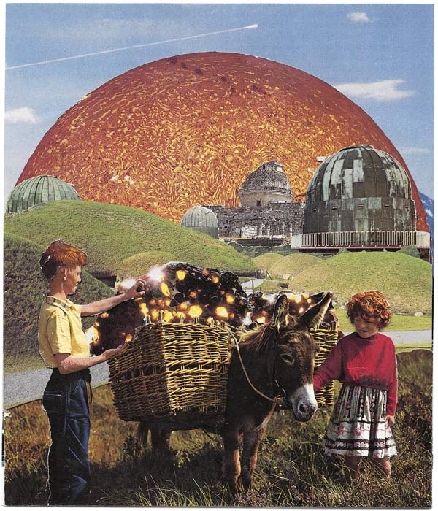
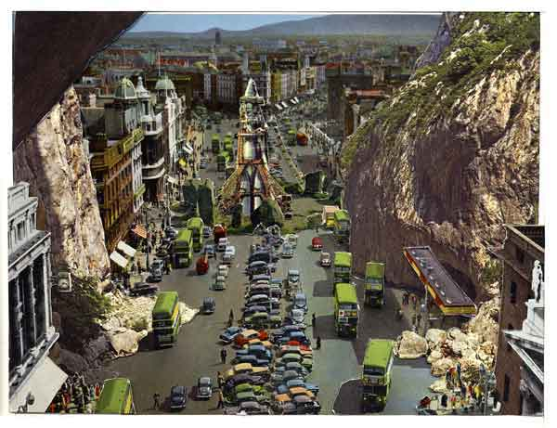
Sean Hillen

Slide 17
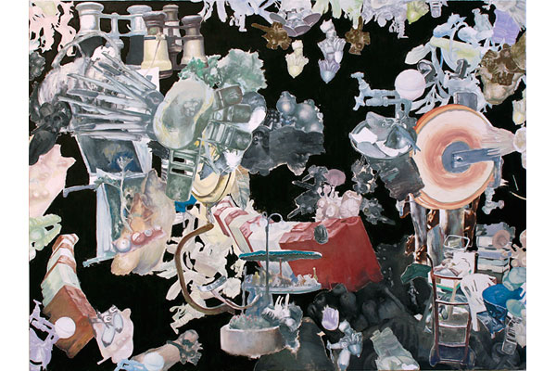
Yutaka Inagawa

Slide 18
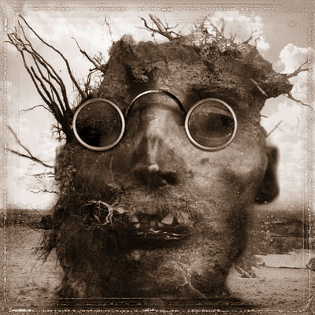
Dave McKean

Slide 19
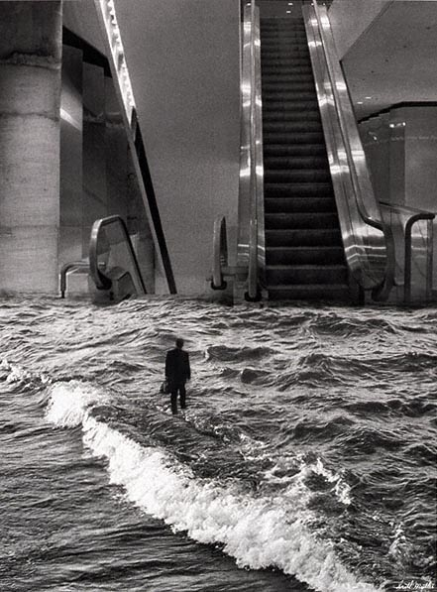
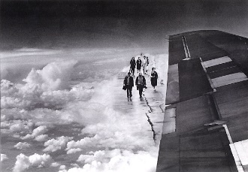
Scott Mutter

Slide 20
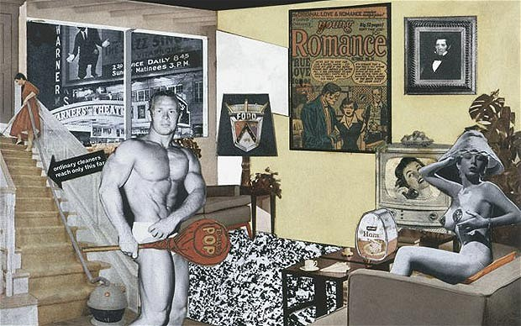
Richard Hamilton

Slide 21
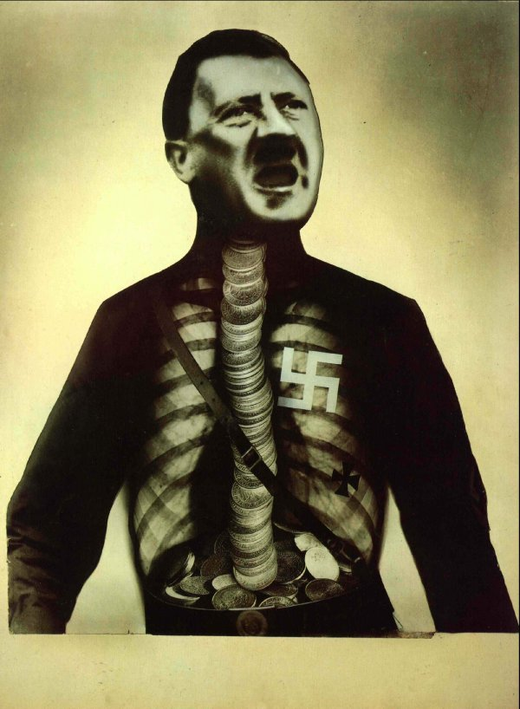
John Heartfield

Slide 22
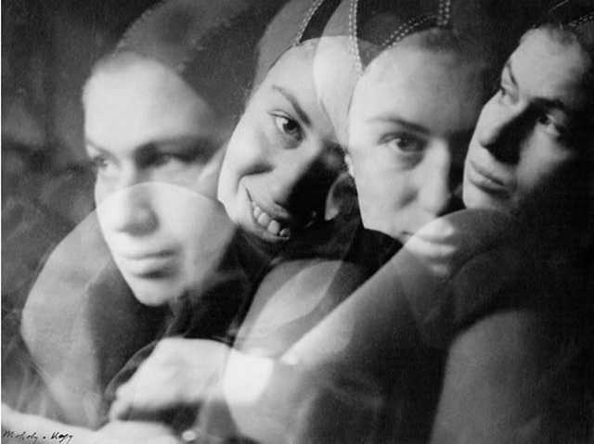
Laszlo Moholy- Nagy

Slide 23
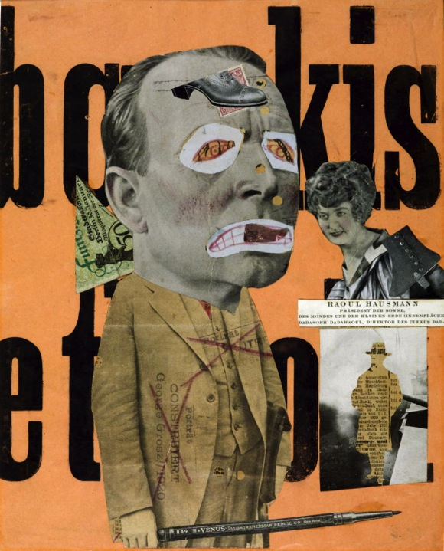
Raoul Hausmann

Slide 24
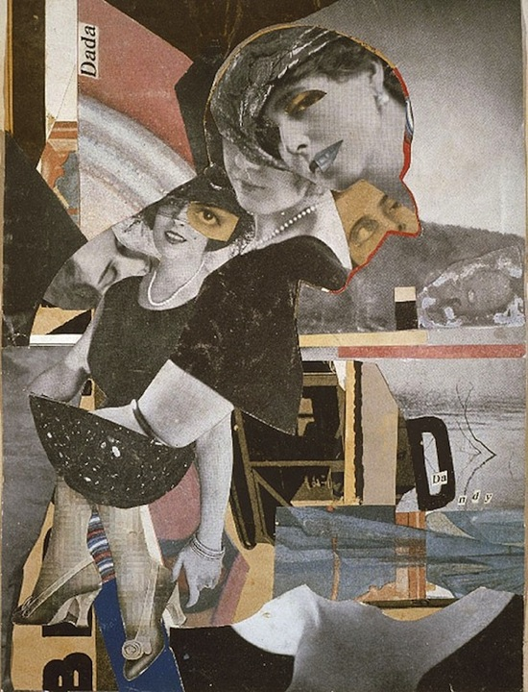
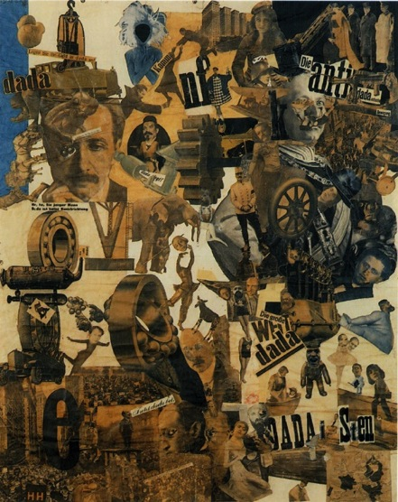
Hannah Hoch

Slide 25
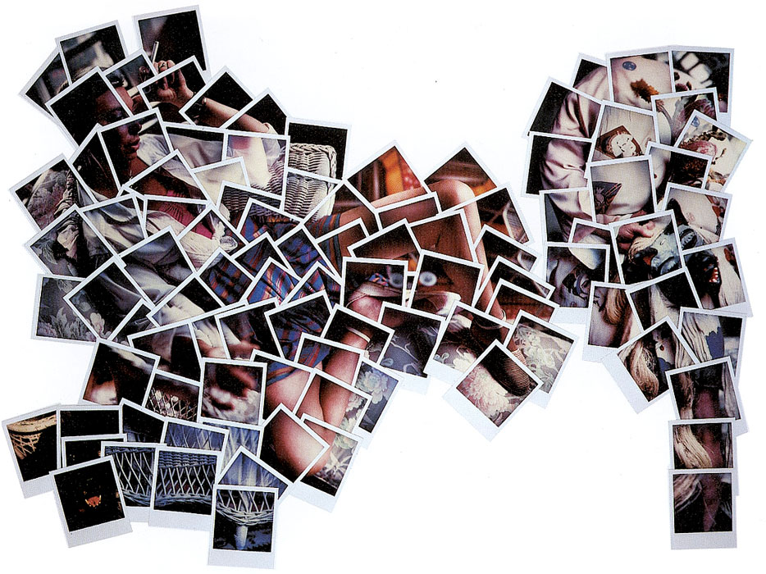
Joyce Neimanas

Slide 26
Coryndon Luxmoore

Slide 27
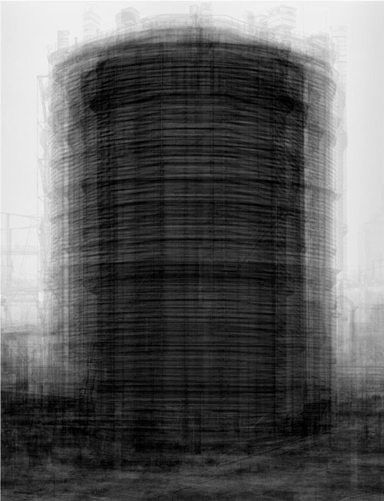
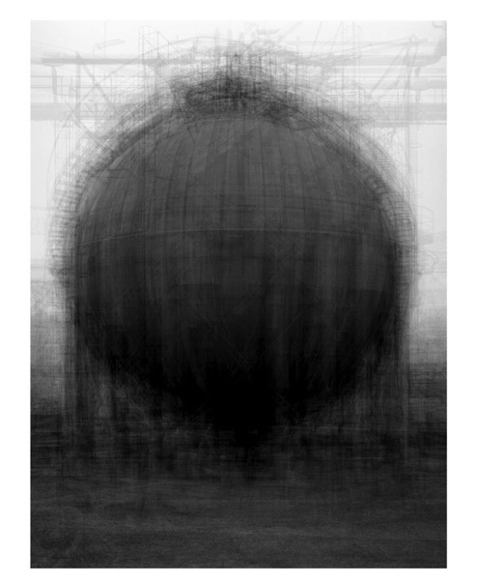
Idris Khan

Slide 28
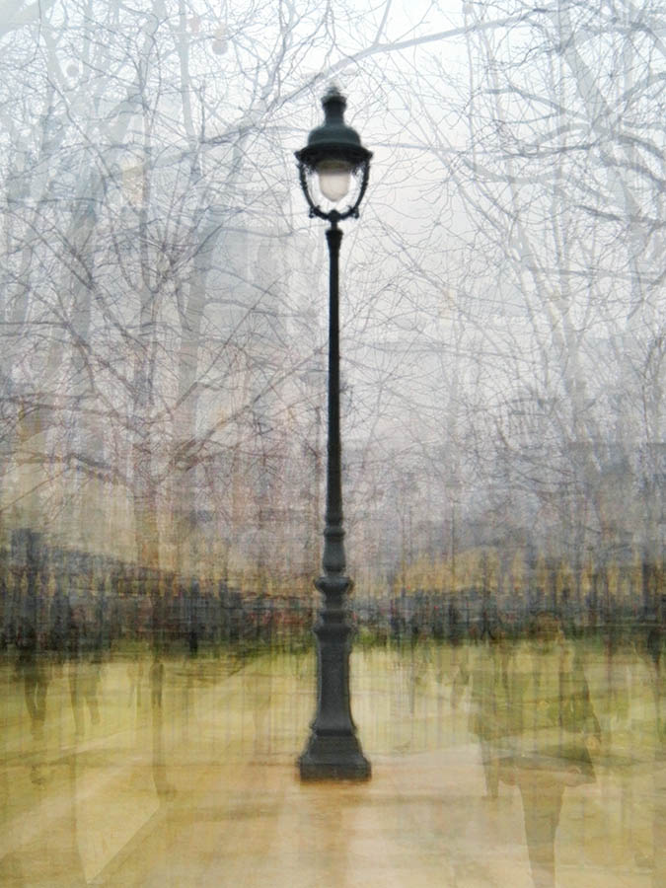
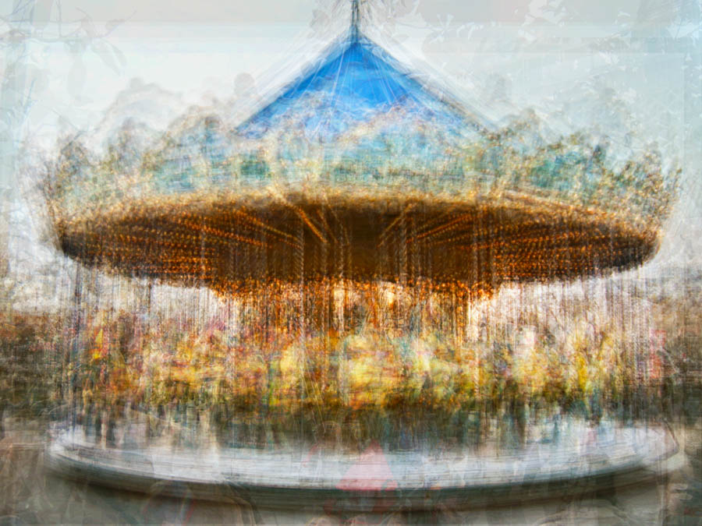
Pep Ventosa

Slide 29
Evidence

Slide 30
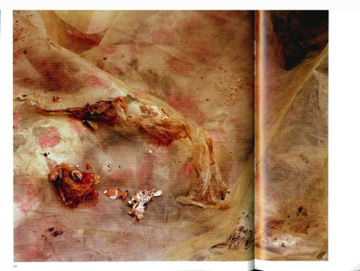
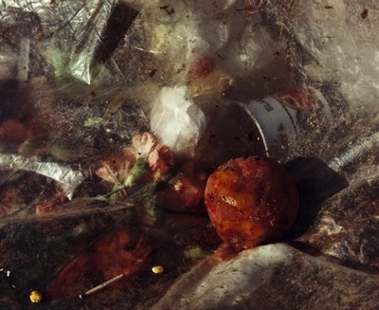
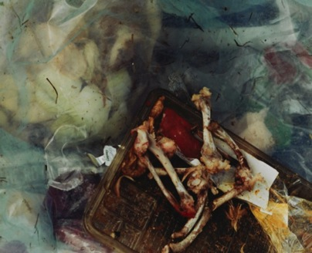
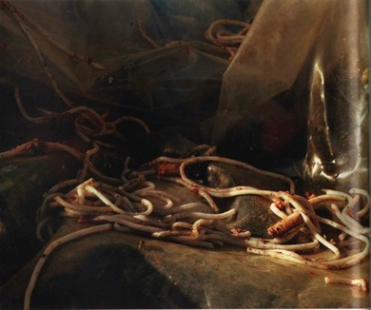
Keith Arnatt
Pictures from a rubbish tip

Slide 31
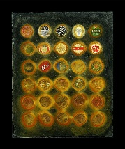
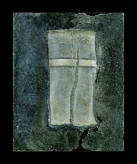
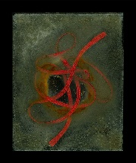
Duncan Unsworth
From The Thames

Slide 32
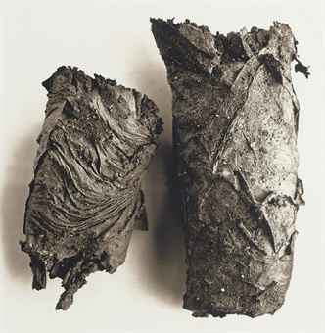
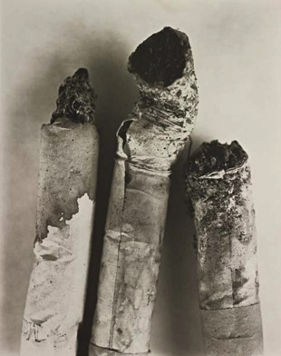
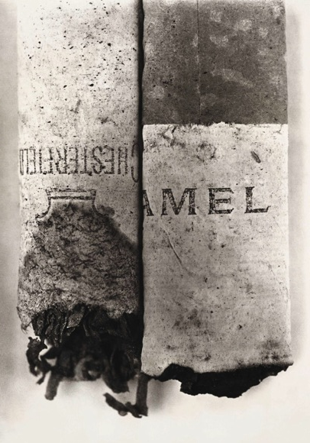
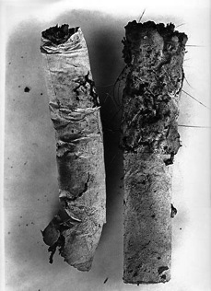
Irving Penn

Slide 33
Peter Fraser

Slide 34
Borut Peterlin

Slide 35
Sophie Calle

Slide 36
Tracey Emin

Slide 37
Tina Modotti
Telephone wires, 1925

Slide 38
Sarah Hobbs
Untitled (Perfectionism),
2002

Slide 39
Brassai
The Red List

Slide 40
Aaron Siskind

Slide 41
Andreas Gursky

Slide 42
Rune Guneruissen

Slide 43
Weather

Slide 44
Jim Reed

Slide 45
Mark Humbage

Slide 46
Stephen Spraggon

Slide 47
Creative use of light

Slide 48
Richard Vantielcke

Slide 49
Aaron Siskind

Slide 50
David Montizambert

Slide 51
Wolfgang Tillmans

Slide 52
Fong Qi Wei

Slide 53
Daniele Buetti

Slide 54
Olivia Parker

Slide 55
Joseph Sudek

